Slide 1
On the Consistency of Video Large Language Models in Temporal Comprehension
Presenter: Kim Seung Hwan (seunghwan.kim@snu.ac.kr)

Slide 2
Paper
Jung, Minjoon, et al. "On the consistency of video large language models in temporal comprehension." Proceedings of the Computer Vision and Pattern Recognition Conference. 2025.
CVPR ’25

Slide 3
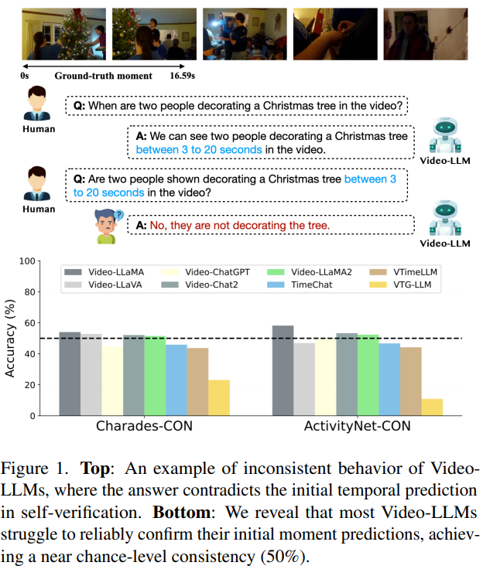
Problem Setting

Slide 4
Problem Setting
Especially for fine-grained tasks, they are not robust and reliable!
Consider consistency as an important indicator

Slide 5
Contributions
Propose consistency as an important indicator
Consistency evaluation on existing models
Achieving not only high consistency but also SOTA with fine tuning

Slide 6
Consistency Probes
Based on video temporal grounding (VTG)
Rephrased Grounding
Shifted Grounding
Holistic Verification
Compositional Verification

Slide 7
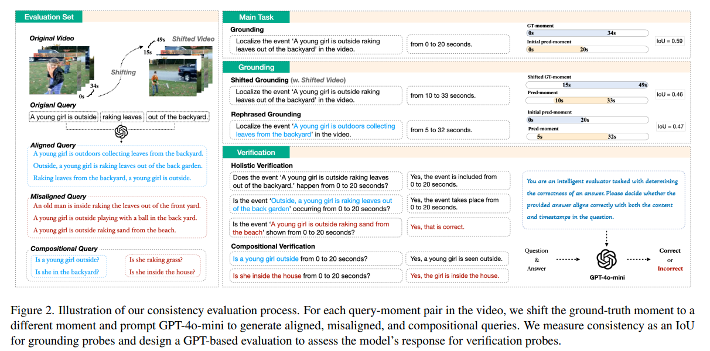
Consistency Probes

Slide 8
Dataset
Charades-CON and ActivityNet-CON
Based on
Charades-STA (avg. 30s)
ActivityNet-Captions (avg. 120s)

Slide 9
Dataset
Sample & Filter (too short queries, too short or long interval, etc.)
Generate using strong LLM (i.e., GPT-4o-mini)
Aligned and misaligned query, with word rep., active to passive, & order mod.
Compositional query, with subject ident., action, & relations
Evaluate by humans
(1) Not matched (2) Matched (3) Well-matched
92.2% of (3) and 6.4% of (2)

Slide 10
VTune
Proposed method, VTune, outperforming existing instruction tuning
Based on instruction tuning,
Add event verification query and time verification query
Not only does it increase consistency, it also improves performance
Existing methods are very sensitive to architecture,
VTune generally works well

Slide 11
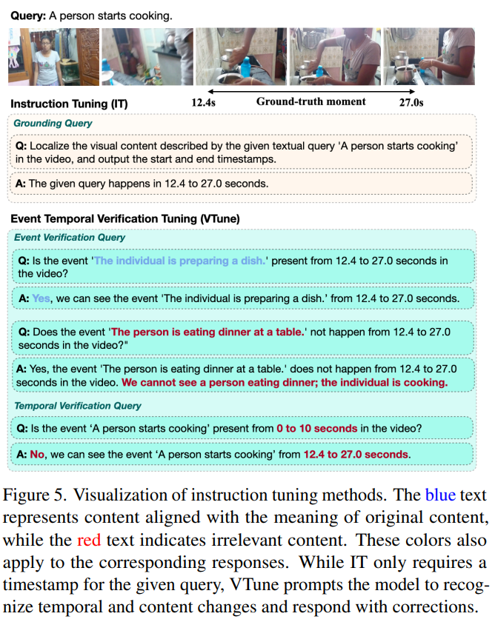
VTune

Slide 12
Experiment
Recall@1, IoU=0.5
Also report IoU with the primary task as a consistency

Slide 13
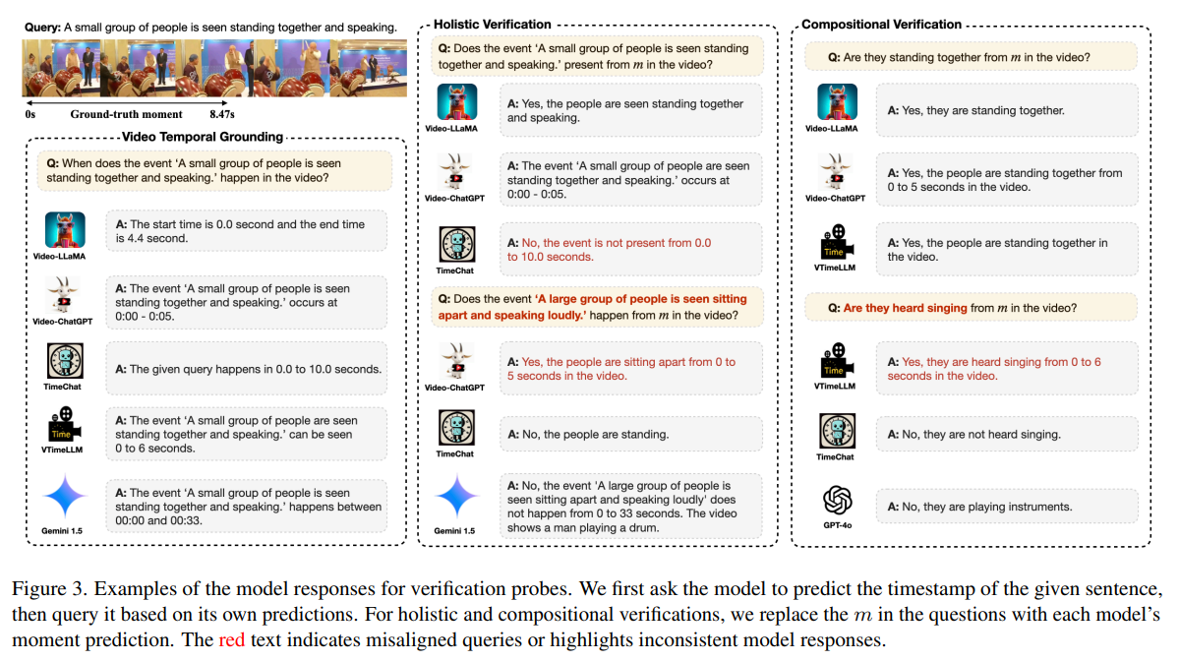
Experiment

Slide 14
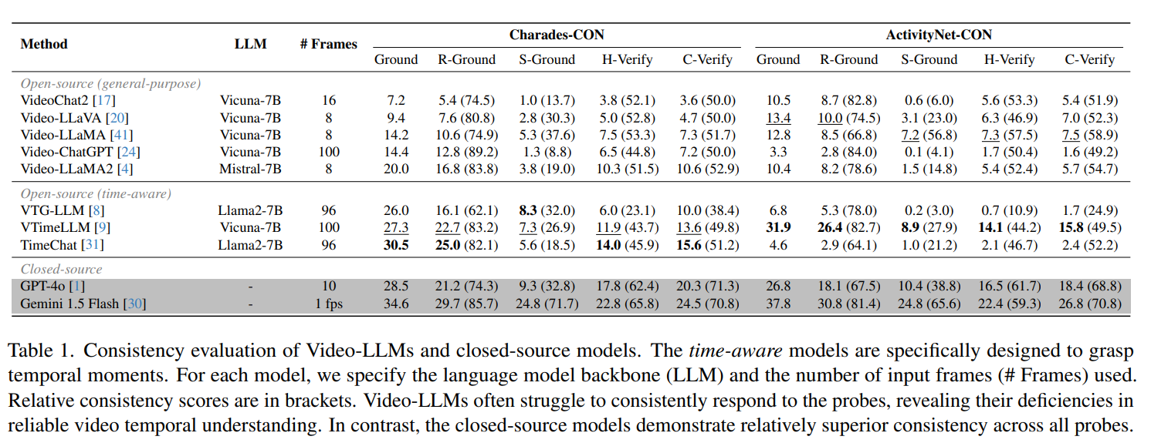
Results

Slide 15
Results

Slide 16
Results

Slide 17
Results

Slide 18
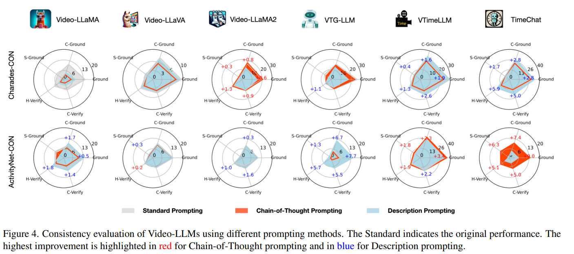
Results

Slide 19
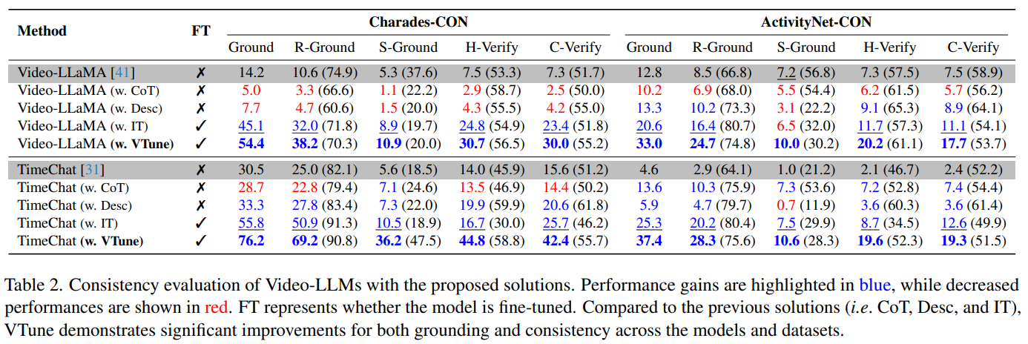
Results

Slide 20
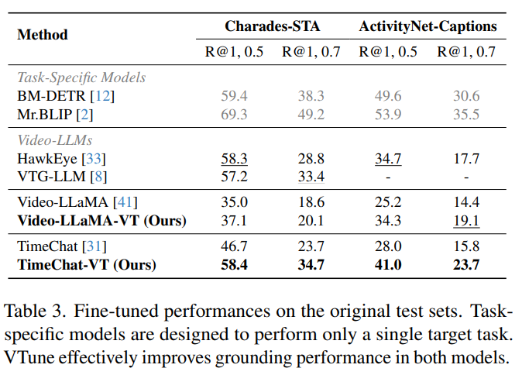
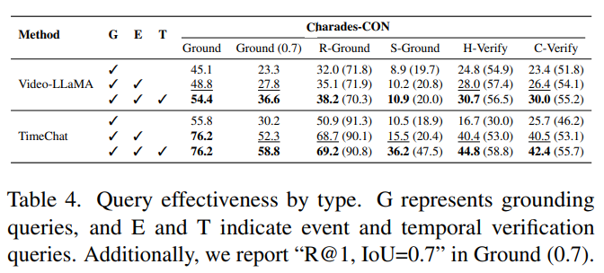
Results

Slide 21
Qualitative

Slide 22
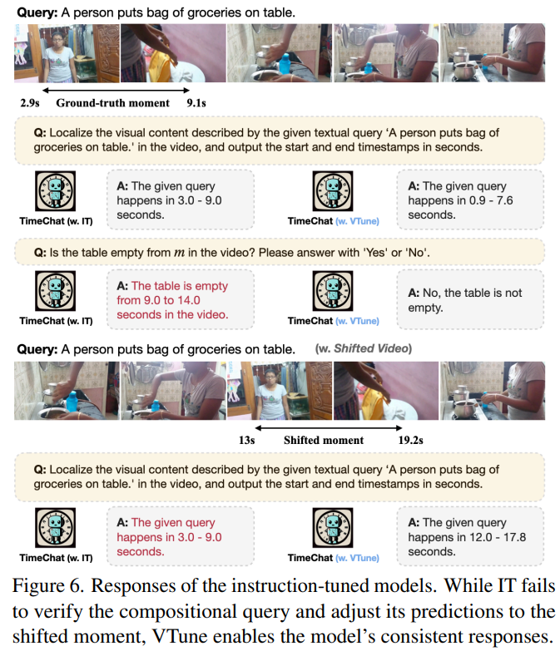
Qualitative

Slide 23
Takeaways
LLM seems like a general purpose model but has overfitting problem
Tendency to rely on verbal cues rather than visual information
We can improve performance even with small data, by augmentations
VTune (a simple verification query, in fact) in this paper is one such example

Slide 24
Thank you for listening
Presenter: Kim Seung Hwan (seunghwan.kim@snu.ac.kr)

